Slide 1
Geo-Visualization Of Industrial Human Resource
Goodwin Blesso I
MDT - 38

Slide 2
Introduction
Problem Statement:
The industrial classification of the workforce is outdated and does not reflect the current workforce distribution labor force across various sectors.
Lack of accurate data affects policy-making and employment planning, leading to inefficient resource allocation.
Objective:
Provide accurate workforce insights to support data-driven decision-making for employment and economic policies.
Develop an user-friendly Streamlit application which should help us to find the distribution labor force across various sectors/Industry Groups.
Benefits:
Accurate Workforce Data – Helps in understanding the latest employment trends.
Improved Policy Making – Supports data-driven labor policies and economic strategies.
Better Employment Planning – Aids in workforce distribution and skill development programs.
Enhanced Industrial Insights – Identifies growth opportunities in different industry sectors.

Slide 3
Overview
Dataset:
Data Source: Industrial workforce data of India
Features: State Code, District Code, Main Workers, Marginal Workers & NIC Name.
Dataset Size: 1,95,145 records
Data Preprocessing:
Merge Dataset: Merged all the datasets of different states into a single data frame (df).
Missing Value Treatment: Check for missing values but there no null values in the df.
Data sanitization: Removal of unwanted commas, spaces, or other unnecessary characters.
Libraries Used:
Pandas
Numpy
Sklearn
Matplotlib
Seaborn
Embedding Clustering: Used Pre-trained Sentence Transformer Embedding Model (sentence-transformers/all-MiniLM-L6-v2) to extract the industry group names from “NIC Name” column. (Used to capture the semantic meaning of industry and group them accordingly)

Slide 4
EDA:
It involves analyzing and visualizing data to understand its structure, detect patterns, and identify anomalies.
Insights:
Highest Workforce Industry
The "Construction" industry group employs the largest number of workers across all sectors.
Worker Type Distribution
The dataset is predominantly composed of Main Workers, significantly outnumbering the Marginal Workers.
Main Workers: Rural vs Urban
Among Main Workers, the Urban population contributes a larger share compared to Rural.
Marginal Workers: Rural vs Urban
In contrast, Rural areas dominate in the Marginal Worker category.
Gender Distribution - Main Workers
Male Main Workers form the majority, with a gender ratio of approximately 80:20 (Male: Female).
Gender Distribution - Marginal Workers
The Marginal Workers show a near-equal gender split, with a ratio of 50.1% Male to 49.9% Female.

Slide 5
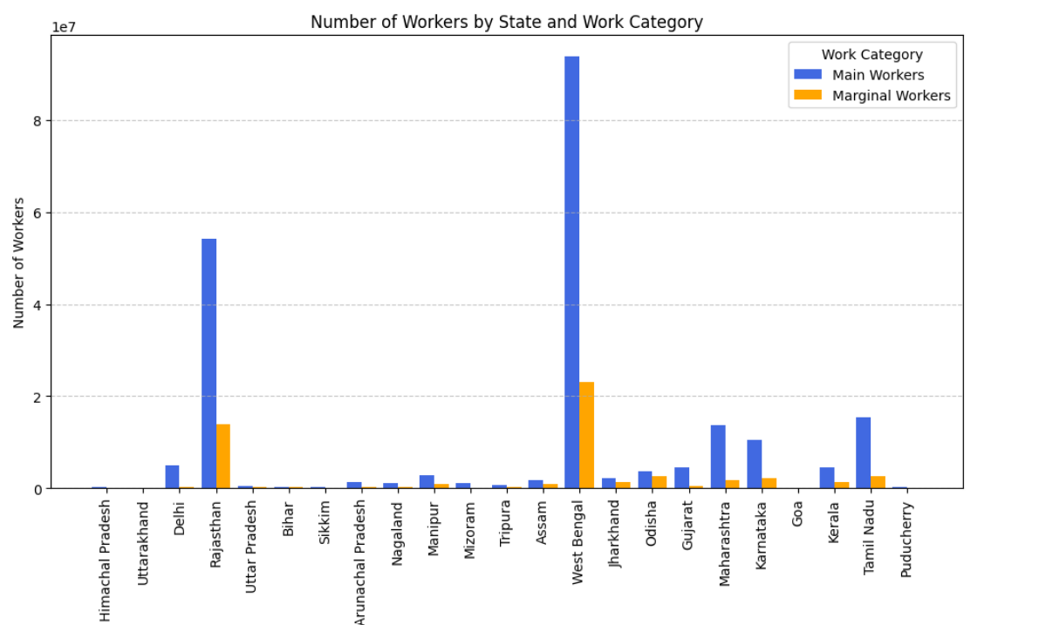
Distribution of workers (State & Work Category):

Slide 6
Model Development:
Dimension Reduction: UMAP (Used to reduce dimensionality while preserving both local and global structure, enhancing clustering performance.)
Algorithm Used: DBSCAN (Chosen for its ability to identify clusters of arbitrary shape and handle noise without needing to predefine the number of clusters.)
Model Evaluation:
Metrics: Silhouette Score & Davies-Bouldin Index
Scores:
Algorithm | Silhouette Score | Davies-Bouldin Index
K-Means | 0.20 | 1.65
DBSCAN | 0.98 | 0.01

Slide 7
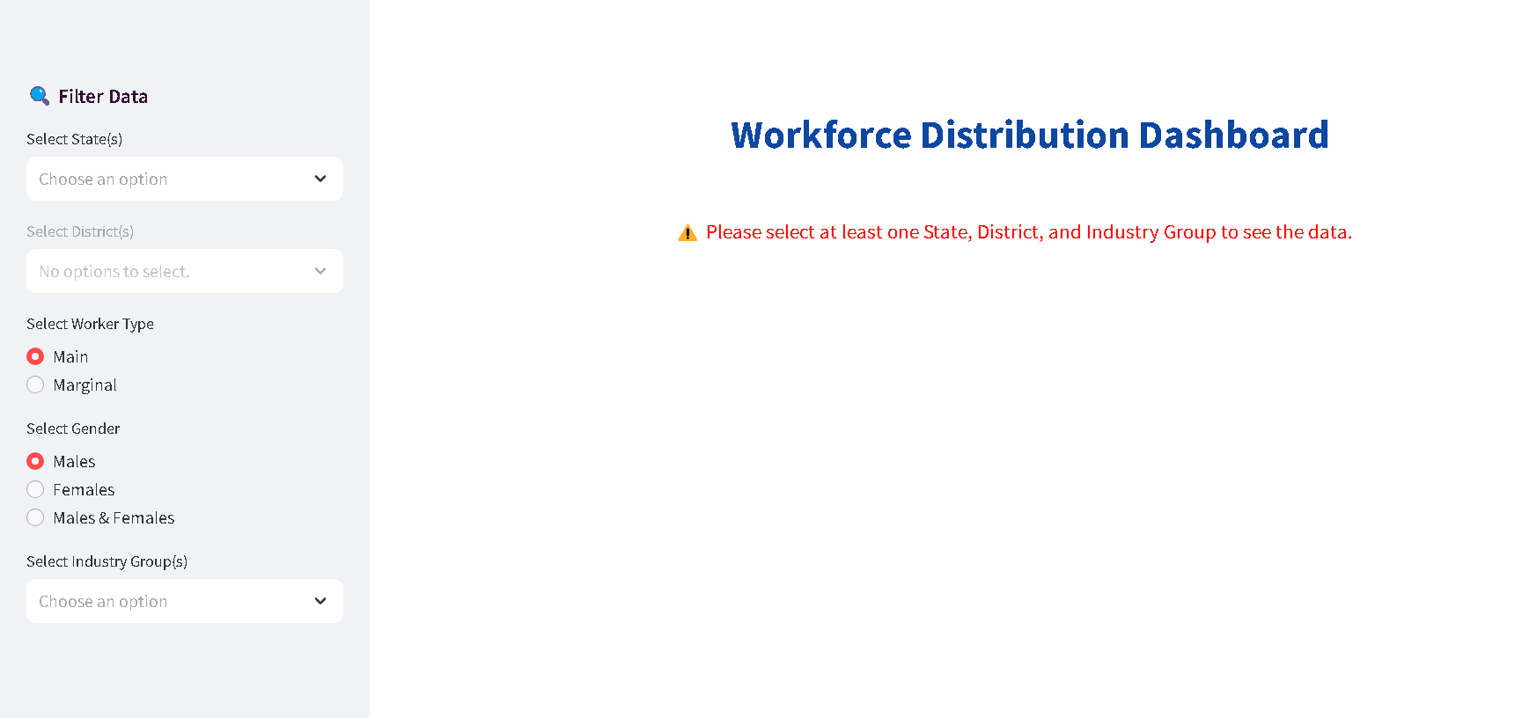
Deployment:
Streamlit Application: Deployed the final model using Streamlit and created an interactive web application, the user interface looks as below:

Slide 8
Application Workflow:
Accessing the Application
Run the steamlit application using the command “streamlit run app.py”
It redirects to the web browser and navigate to the Workforce Distribution app.
Select the options
Navigate to the “Filter Data” section on the left-hand side of the dashboard.
Apply filters using the following options:
State: Select from the dropdown list.
District: Choose your desired district from the dropdown.
Worker Type: Use radio buttons to select Main or Marginal workers.
Gender: Use radio buttons to choose Male or Female.
Industry Group: Select the industry group from the dropdown.
On the right-hand side, view dynamic visualizations of the worker population to analyze business-related insights.

Slide 9
Visualization Insights:
A total of 25 distinct industry groups were identified through clustering analysis.
The "Construction" industry employs the highest number of workers — approximately 48 million.
The "Transport" industry has the least workforce, with around 1.3 million workers.
Within the "Construction" industry, there are 32 million Main workers and 15 million Marginal workers.
Male workers dominate most industries, except "Domestic Work", where female participation is higher.
West Bengal has the highest number of workforce across all other states.
Conclusion:
Developed a machine learning clustering model that helps us to uncovered key workforce distribution patterns across different industries.
These insights can support policymakers and businesses in strategic planning, targeted workforce development, and informed decision-making.

Slide 10
Thank You

